Slide 1

Notes:
I think we can all agree that ads can be a bit bothersome sometimes. Right?
In today’s presentation we will touch on the technologies behind it and why they are not only bothersome but intrusive and disruptive.
Introduce my self: My name is Albert and this is my partner Lance and and today
we will discuss how ads invade your Privacy and what you can do to prevent this by showing you how to kill the ads and keep your privacy.

Slide 2
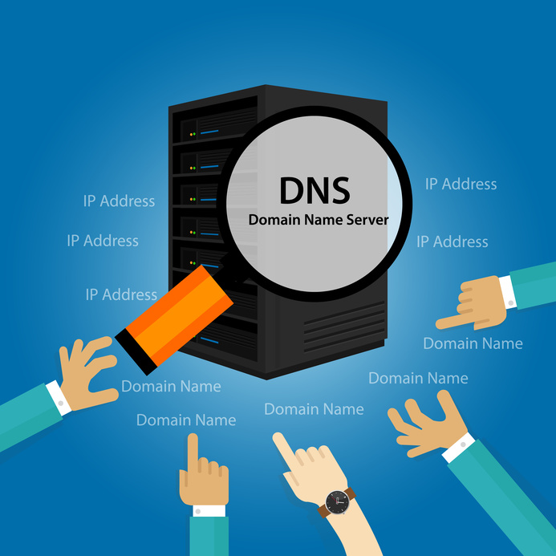
What is DNS?
Notes:
How do these ads get to us in the first place? Through DNS. DNS stands for Domain Name Systems. This is an ancient protocol from the dawn of the Internet and it is something you use every time you access the internet.
It is in charge of translating simple text addresses aka Domains like latimes.com into IP addresses that the servers will use to deliver the website to us.
Let’s dig a little deeper on how exactly this process works.

Slide 3
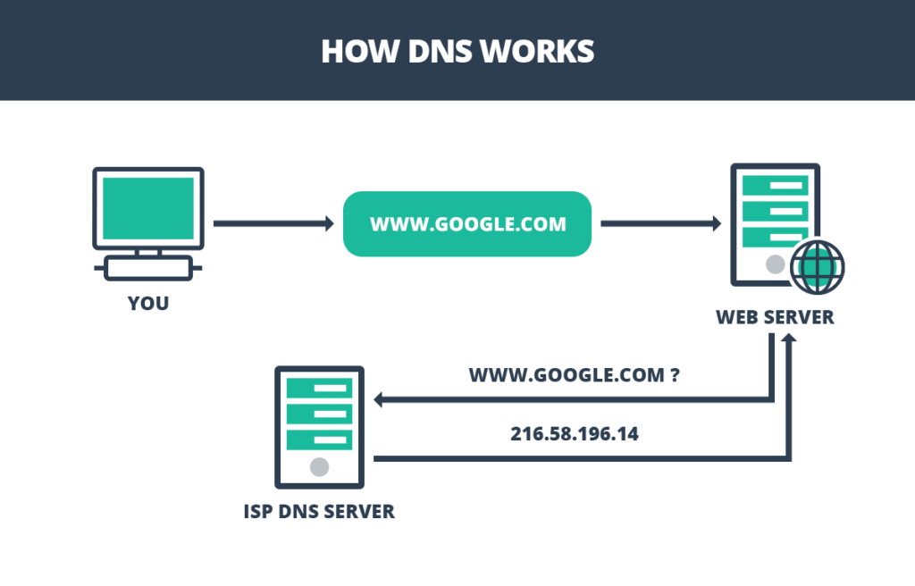
Notes:
Here we can see that our computer is accessing google.com. To do this it asks our ISPs or Internet Service Providers’ dns server, like frontier or spectrum, for the IP address associated with google.com.
Once found, it returns the website to us in mere milliseconds.

Slide 4
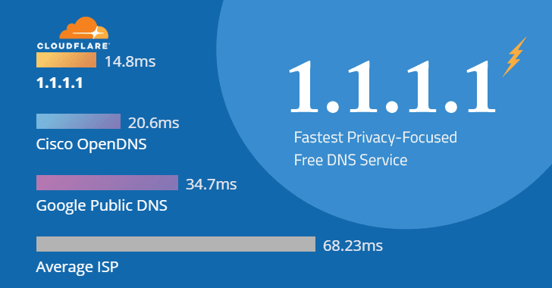
Alternative DNS Servers
Notes:
This chart shows the most popular alternative DNS Servers ranked by speed.
Cloudflare is the number one with a speed of 14 ms followed by Cisco OpenDNS with a speed of 20ms and Google Public DNS with a speed of 34ms.
As you can see, there’s a clear benefit to switching your dns server, since average ISP’s will take more than half the time to load your websites.
Given all of these great benefits I would like to introduce you to a real world scenario where DNS servers actually saved lives.

Slide 5
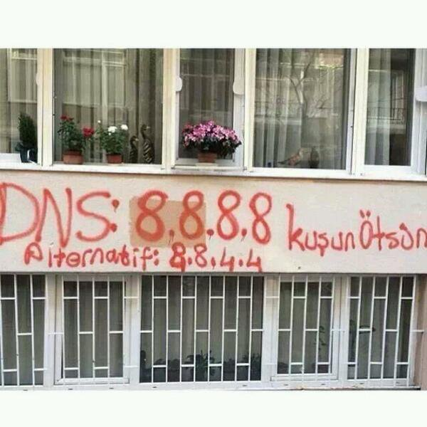
Why is it important?
Notes:
Spray painted on to the wall we have googles public DNS.
During the Arab Spring of 2010-2012 Egypt and other countries blocked internet access to its citizens.
To do this all they did was to shut down the ISP’ers.
In order to do that these countries shut down or blocked ths DNS serve access to the Internet Service Providers DNS servers.
The people revolting knew about this and started to graffiti google’s DNS address on the streets.
Soon people realized that thanks to this graffitti they could access the Internet and communicate with the rest of the world the injustices going on in their home countries.

Slide 6
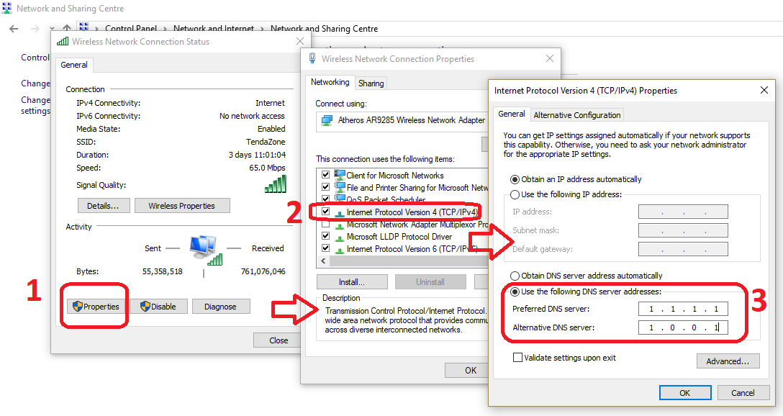
How to change your DNS
Notes:
This picture shows how to enable and disable DNS in Windows. it’s 3 simple steps

Slide 7
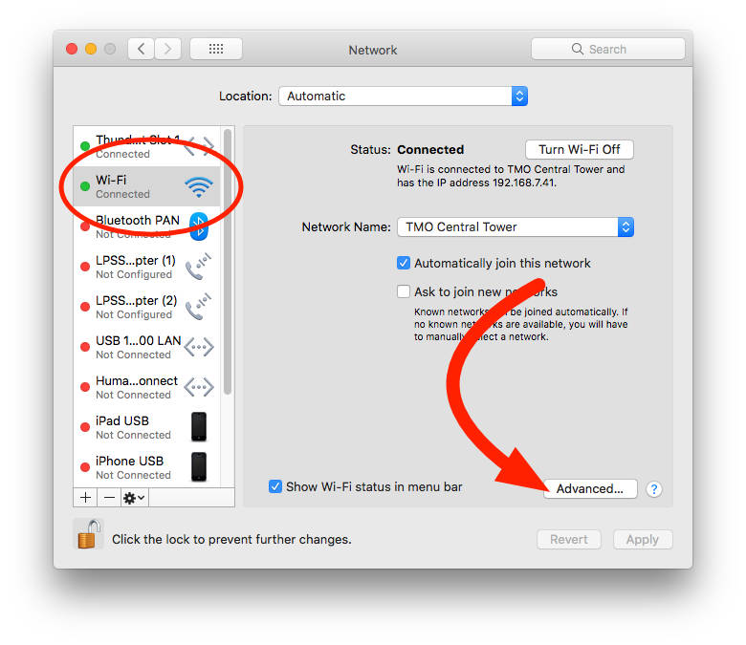
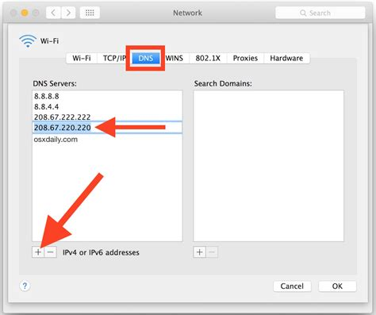
How to change your DNS
Notes:
Now that you know how to change the DNS server on your home computer
let me explain how making your own can benefit you.

Slide 8
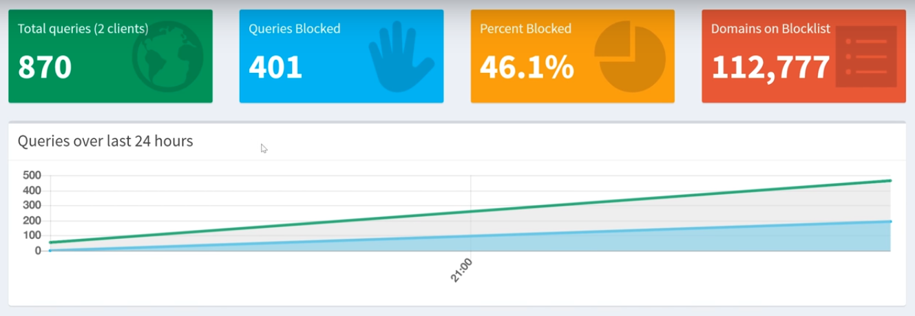
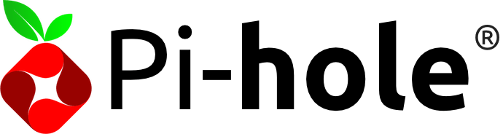
Privacy On - Benefits
Keep your privacy!
Block advertisements before they reach your browser
Manage and analyze DNS data with Pi-Hole!
Notes:
Pi-hole is customizable DNS server that takes its name after the raspberry pi. What’s special about this secondary dns server is that it keeps our privacy by blocking advertisements before they reach your browser. Pi-hole filters unwanted request from domains like brita filters impurities out of water.
The filtering process works by feeding it a list of advertisement and Malicious domains.
The benefits as you can see are mainly to keep your privacy and encourage a higher quality browsing experience.

Slide 9
Privacy Off - Drawbacks
Our data is the 21st Century Oil!
Every major site uses trackers
Companies Manage Data differently
You have no control over it
Notes:
Privacy off is our way of explicitly saying this is the regular internet.
When you open Facebook you are actually opening up dozens of webpages. These pages are
ads, trackers, and even malware! They slow your web browsing, eat your mobile data, and leave a trail of your internet activities for advertisers and companies to use.
We have some examples of multiples trackers being blocked on frequently visited websites.
As you can see from amazon, reddit, and cnn.com, ghostery our ad blocker of choice in the red circle has blocked 3 ads and trackers on amazon, 5 in reddit, and 26 on cnn.com
Without ad blockers your are prone to companies collecting your data

Slide 10






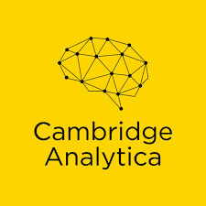
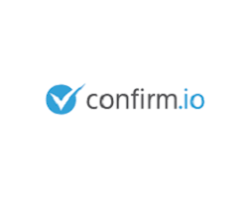
Companies that mine your information
Notes:
In this example we see a few companies you may never heard about that have purchased and used your data such as Scout, REAL FACE, Legbacore, and many others. To access this data they partnered with large companies that have collected your data such as amazon alexa, Apple, Facebook, and many more.
Albert: To further illustrate this point

Slide 11

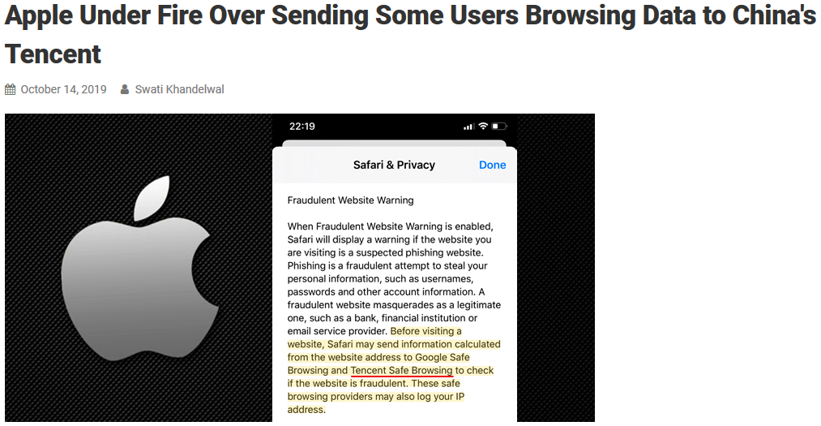
Notes:
This is a perfect example of a known corporation selling data to Tencent which is China’s major news outlet equivalent to CNN in america.
In this case you can’t control what apple does with your data, let’s go into a case where

Slide 12
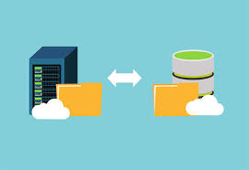
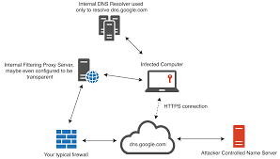
DNS Threats
DNS Zone Transfer
DNS Data Exfiltration
Notes:
DnS zone transfer : Grab all the host information from a given DNS server giving a view of al the internal IP addresses inside an organization. A good analogy for this is if I were to go to a hotel and ask the clerk to tell me the name of everyone in their respective rooms.
DNS data exfil: Smuggling data over a covert channel. There will be a full blown demonstration on this at “X time” .

Slide 13
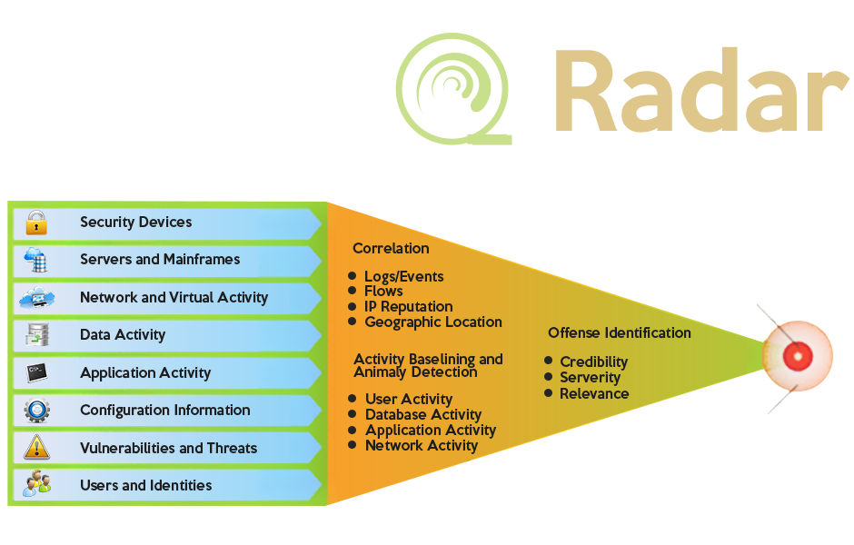
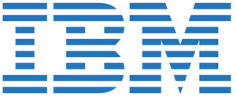
Security Information and Event Management(SIEM)
Notes:
To catch theses threats happening companies have software monitoring and analyzing all the network traffic. This software is known as a Security Information and Event Management or SIEM for short. There are many SIEMs and for this example we will show IBM Qradar. We can think of them as fancy traffic inspectors!

Slide 14
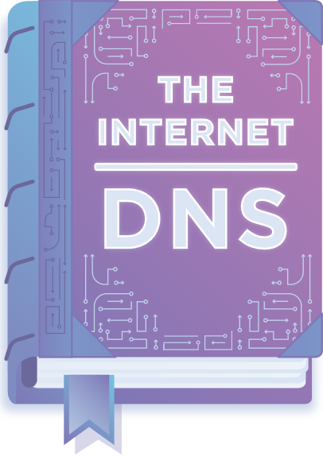
Summary
Define what is a DNS.
How can DNS affect you.
How can Pi-Hole help you.
Notes:
What does DNS stand for? <see if anyone knows> Respond by: Dns is short for a Domain Naming System.
As you now know while browsing the Internet you are interacting with a DNS server but behind the scenes when visiting your favorite site, there are many other DNS requests tagging along.
All this can be mitigated effectively by a Pi-Hole similarly to an ad-block but with a fun learning experience which you can build yourself today at our Pi-Hole Workshop!
Albert:
Let us know if you have questions, we are willing to help with anything,
Don’t forget to sign in and we will send you a email with more resources as well as documentation for you to build the pi-hole, how to change your dns, and how to defend your organization against DNS attacks.

Slide 15
Sources
https://www.cyberkey.in/cloudflare-public-dns-1-1-1-1-fast-with-privacy-alternative-of-google-dns/
https://www.cbinsights.com/research/facebook-amazon-microsoft-google-apple-cybersecurity/
https://www.webhostingsun.com/wp-content/uploads/2016/06/WHS-DNS-server-693x693.jpg
https://www.vice.com/en_us/article/9kembz/comcast-lobbying-against-doh-dns-over-https-encryption-browsing-data

